Slide 1
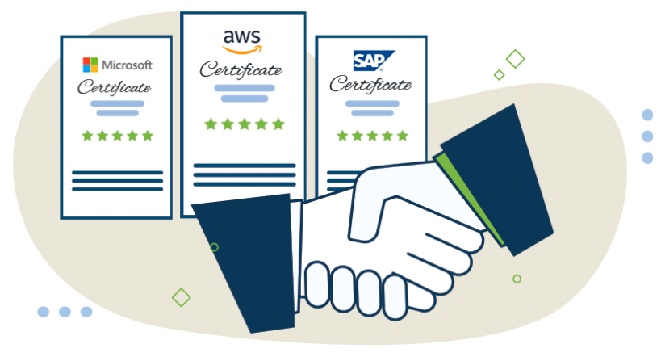

SEO Analysis& Audit Report Sep 2021

Slide 2
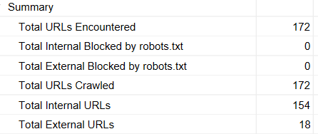
https://ty-education.com/
https://fonts.googleapis.com/css?family=Muli:400,600,700,800,900&display=swap
https://www.facebook.com/tr?id=537494160776221&ev=PageView&noscript=1
https://code.jquery.com/jquery-3.1.1.min.js
https://www.youtube.com/channel/UC-HTxdXwvUfp3aYyxqMYlqA
https://www.facebook.com/TYEducationInc
https://www.linkedin.com/company/tyeducation
https://unpkg.com/sweetalert@2.1.0/dist/sweetalert.min.js
https://twitter.com/TYEducation1
http://40.121.223.140/course
https://en.wikipedia.org/wiki/Business_strategy
http://159.89.0.139/dummy-header.png
https://en.wikipedia.org/wiki/Mindshare
https://en.wikipedia.org/wiki/Leadership
https://www.tytir.com/
https://www.facebook.com/TY-Tir-100177172188496
https://www.nortonlifelock.com/in/en/
https://code.jquery.com/jquery-1.11.3.min.js
https://www.instagram.com/tytir.id/

Slide 3
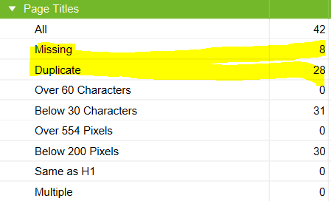
Title
https://catalog.ty-education.com/tyedu_uscourses
https://catalog.ty-education.com/tyedu_canadacourses
https://catalog.ty-education.com/coursevod?lang=1
https://catalog.ty-education.com/tyedu_indiacourses
https://catalog.ty-education.com/tyedu_indonesiacourses
https://catalog.ty-education.com/tyedu_ukcourses
https://catalog.ty-education.com/tyedu_uaecourses
https://catalog.ty-education.com/course_catalog
https://ty-education.com/
https://ty-education.com/uae-iselect.php
https://ty-education.com/techforbusiness.php
https://ty-education.com/partners.php
https://ty-education.com/uk-iselect.php
https://ty-education.com/indonesia-iselect.php
https://ty-education.com/lifelongskills.php
https://ty-education.com/ty-tir.php
https://ty-education.com/ourvision.php
https://ty-education.com/deliverymodel.php
https://ty-education.com/businessfortech.php
https://ty-education.com/india-iselect.php
https://ty-education.com/insurance-agents.php
https://ty-education.com/pressrelease.php
https://ty-education.com/wilpower.php
https://ty-education.com/certifications.php
https://ty-education.com/privacy-policy.php
https://ty-education.com/bootcamp.php
https://ty-education.com/instructors.php
https://ty-education.com/ourteam.php
https://ty-education.com/VOD.php
https://ty-education.com/canada-iselect.php
https://ty-education.com/alliances.php
https://ty-education.com/usa-iselect.php
https://ty-education.com/students.php
http://lms.ty-education.com/course/index.php?categoryid=13
http://lms.ty-education.com/course/index.php?categoryid=11
http://lms.ty-education.com/course/index.php?categoryid=10

Slide 4
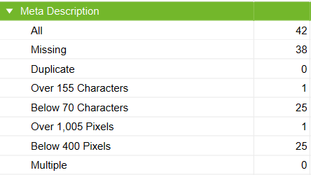
Description
https://ty-education.com/
https://ty-education.com/uae-iselect.php
https://ty-education.com/techforbusiness.php
https://ty-education.com/partners.php
https://ty-education.com/uk-iselect.php
https://ty-education.com/indonesia-iselect.php
https://ty-education.com/lifelongskills.php
https://ty-education.com/ty-tir.php
https://ty-education.com/ourvision.php
https://ty-education.com/deliverymodel.php
https://ty-education.com/businessfortech.php
https://ty-education.com/india-iselect.php
https://ty-education.com/insurance-agents.php
https://ty-education.com/pressrelease.php
https://ty-education.com/wilpower.php
https://ty-education.com/certifications.php
https://ty-education.com/privacy-policy.php
https://ty-education.com/bootcamp.php
https://ty-education.com/instructors.php
https://ty-education.com/ourteam.php
https://ty-education.com/VOD.php
https://ty-education.com/canada-iselect.php
https://ty-education.com/alliances.php
https://ty-education.com/usa-iselect.php
https://ty-education.com/students.php
https://catalog.ty-education.com/tyedu_uscourses
https://catalog.ty-education.com/tyedu_canadacourses
https://catalog.ty-education.com/coursevod?lang=1
http://lms.ty-education.com/login/forgot_password.php
http://lms.ty-education.com/course/index.php
http://lms.ty-education.com/course/index.php?categoryid=13
http://lms.ty-education.com/course/index.php?categoryid=11
http://lms.ty-education.com/course/index.php?categoryid=10
https://catalog.ty-education.com/tyedu_indiacourses
https://catalog.ty-education.com/tyedu_indonesiacourses
https://catalog.ty-education.com/tyedu_ukcourses
https://catalog.ty-education.com/tyedu_uaecourses
https://catalog.ty-education.com/course_catalog

Slide 5
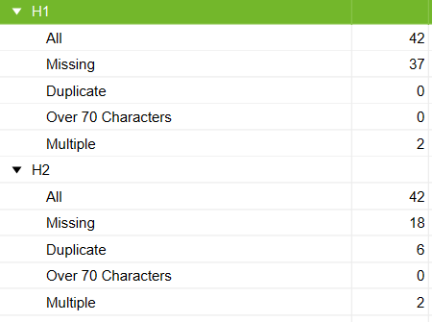
Header Tags & LCP
https://ty-education.com/uae-iselect.php
https://ty-education.com/techforbusiness.php
https://ty-education.com/partners.php
https://ty-education.com/uk-iselect.php
https://ty-education.com/indonesia-iselect.php
https://ty-education.com/lifelongskills.php
https://ty-education.com/ty-tir.php
https://ty-education.com/deliverymodel.php
https://ty-education.com/businessfortech.php
https://ty-education.com/india-iselect.php
https://ty-education.com/insurance-agents.php
http://lms.ty-education.com/
https://ty-education.com/pressrelease.php
https://ty-education.com/wilpower.php
https://ty-education.com/certifications.php
https://ty-education.com/privacy-policy.php
https://ty-education.com/bootcamp.php
https://ty-education.com/instructors.php
https://ty-education.com/ourteam.php
https://ty-education.com/VOD.php
https://ty-education.com/canada-iselect.php
https://ty-education.com/alliances.php
https://ty-education.com/usa-iselect.php
https://ty-education.com/students.php
https://catalog.ty-education.com/tyedu_uscourses
https://catalog.ty-education.com/tyedu_canadacourses
https://catalog.ty-education.com/coursevod?lang=1
http://lms.ty-education.com/login/forgot_password.php
http://lms.ty-education.com/course/index.php
http://lms.ty-education.com/course/index.php?categoryid=13
http://lms.ty-education.com/course/index.php?categoryid=11
http://lms.ty-education.com/course/index.php?categoryid=10
https://catalog.ty-education.com/tyedu_indiacourses
https://catalog.ty-education.com/tyedu_indonesiacourses
https://catalog.ty-education.com/tyedu_ukcourses
https://catalog.ty-education.com/tyedu_uaecourses
https://catalog.ty-education.com/course_catalog
https://ty-education.com/
https://ty-education.com/ourvision.php
https://ty-education.com/uae-iselect.php
https://ty-education.com/partners.php
https://ty-education.com/uk-iselect.php
https://ty-education.com/indonesia-iselect.php
https://ty-education.com/india-iselect.php
https://ty-education.com/instructors.php
https://ty-education.com/VOD.php
https://ty-education.com/canada-iselect.php
https://ty-education.com/usa-iselect.php
https://ty-education.com/students.php
https://catalog.ty-education.com/tyedu_uscourses
https://catalog.ty-education.com/tyedu_canadacourses
https://catalog.ty-education.com/coursevod?lang=1
https://catalog.ty-education.com/tyedu_indiacourses
https://catalog.ty-education.com/tyedu_indonesiacourses
https://catalog.ty-education.com/tyedu_ukcourses
https://catalog.ty-education.com/tyedu_uaecourses
https://catalog.ty-education.com/course_catalog
http://lms.ty-education.com/
http://lms.ty-education.com/login/forgot_password.php
http://lms.ty-education.com/course/index.php
http://lms.ty-education.com/course/index.php?categoryid=13
http://lms.ty-education.com/course/index.php?categoryid=11
http://lms.ty-education.com/course/index.php?categoryid=10

Slide 6
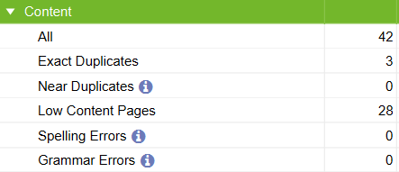
Content
https://ty-education.com/partners.php
https://ty-education.com/instructors.php
https://ty-education.com/students.php
https://ty-education.com/uae-iselect.php
https://ty-education.com/partners.php
https://ty-education.com/uk-iselect.php
https://ty-education.com/indonesia-iselect.php
https://ty-education.com/ty-tir.php
https://ty-education.com/india-iselect.php
https://ty-education.com/privacy-policy.php
https://ty-education.com/instructors.php
https://ty-education.com/ourteam.php
https://ty-education.com/VOD.php
https://ty-education.com/canada-iselect.php
https://ty-education.com/alliances.php
https://ty-education.com/usa-iselect.php
https://ty-education.com/students.php
https://catalog.ty-education.com/tyedu_uscourses
https://catalog.ty-education.com/tyedu_canadacourses
https://catalog.ty-education.com/coursevod?lang=1
http://lms.ty-education.com/login/forgot_password.php
http://lms.ty-education.com/login/signup.php
http://lms.ty-education.com/course/index.php
http://lms.ty-education.com/course/index.php?categoryid=11
http://lms.ty-education.com/login/index.php
https://catalog.ty-education.com/tyedu_indiacourses
https://catalog.ty-education.com/tyedu_indonesiacourses
https://catalog.ty-education.com/tyedu_ukcourses
https://catalog.ty-education.com/tyedu_uaecourses
http://lms.ty-education.com/login/
https://catalog.ty-education.com/course_catalog

Slide 7
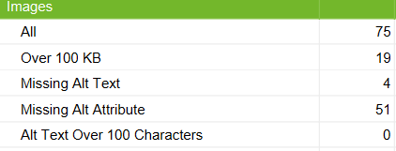
Images
https://ty-education.com/images/slider/crash-course.png
https://ty-education.com/images/courses/course-1-img.jpg
https://ty-education.com/images/slider/certifications.png
https://ty-education.com/images/courses/course-2-img.jpg
https://ty-education.com/images/courses/course-4-img.jpg
https://ty-education.com/images/slider/project-based-training.png
https://ty-education.com/images/slider/know-technologies.png
https://ty-education.cotym/images/ty-tir-home.png
https://ty-education.com/images/slider/training-programs.png
https://ty-education.com/images/courses/course-5-img.jpg
https://ty-education.com/images/slider/alliances.png
https://ty-education.com/images/slider/certifications-vision.png
http://159.89.0.139/dummy-header.png
https://ty-education.com/images/slider/author-teams.png
https://ty-education.com/images/slider/initial-programs-set.png
https://ty-education.com/images/slider/delivery-model.png
https://ty-education.com/images/women-empowerment.png
https://ty-education.com/images/about-us.png
https://ty-education.com/images/coming-soon.jpg
https://ty-education.com/images/team/zaki.jpg
https://ty-education.com/images/team/mbolton.jpg
https://ty-education.com/images/team/theresa-kushner.jpg
https://ty-education.com/images/team/deepak-mukundam.jpg
https://ty-education.com/images/team/uriridiakoghene.jpg
https://ty-education.com/images/team/noimage.png
https://ty-education.com/images/team/monica.jpg
https://ty-education.com/images/team/valariegilbert.jpg
https://ty-education.com/images/team/nishant.jpg
https://ty-education.com/images/team/setyena.jpg
https://ty-education.com/images/team/jay-thomas.jpg
https://ty-education.com/images/team/shivamoozoun.png
https://ty-education.com/images/team/jayanta.jpg
https://ty-education.com/images/team/semin.jpg
https://ty-education.com/images/team/shailaja.jpg
https://ty-education.com/images/team/mukesh.jpg
https://ty-education.com/images/flag/india-flag-b.jpg
https://ty-education.com/images/flag/usa-flag-b.jpg
https://ty-education.com/images/privacy-policy.png
https://ty-education.com/images/slider/certifications-vision.png
https://ty-education.com/images/slider/author-teams.png
https://ty-education.com/images/slider/initial-programs-set.png
https://ty-education.com/images/slider/delivery-model.png
https://ty-education.com/images/women-empowerment.png
https://ty-education.com/images/about-us.png
https://ty-education.com/images/coming-soon.jpg
https://www.ty-education.com/images/logo.png
https://catalog.ty-education.com/public/assets/images/poweredby-tye-logo.png
https://catalog.ty-education.com/public/assets/images/nl-logo.png
https://catalog.ty-education.com/public/assets/images/colored-lines.png
https://catalog.ty-education.com/public/assets/images/poweredby-tye-logo-w.png
https://ty-education.com/images/slider/crash-course.png
https://www.facebook.com/tr?id=537494160776221&ev=PageView&noscript=1
https://ty-education.com/images/flag/uae-flag.jpg
https://ty-education.com/images/slider/certifications.png
https://ty-education.com/images/logo.png
https://ty-education.com/images/flag/canada-flag.jpg
https://ty-education.com/images/slider/know-technologies.png
https://ty-education.com/images/flag/usa-flag.jpg
https://ty-education.com/images/ty-tir-home.png
https://ty-education.com/images/flag/indonesia-flag.jpg
https://ty-education.com/images/slider/training-programs.png
https://ty-education.com/images/flag/india-flag.jpg
https://ty-education.com/images/flag/uk-flag.jpg
https://ty-education.com/images/partners/sap.jpg
https://ty-education.com/images/partners/amazon-web-services.jpg
https://ty-education.com/images/partners/microsoft.jpg
https://ty-education.com/images/partners/google-cloud.jpg
https://ty-education.com/images/slider/alliances.png
https://ty-education.com/images/partners/ibm.jpg
https://ty-education.com/images/team/jayesh.jpg
http://lms.ty-education.com/pluginfile.php/192/course/overviewfiles/Make%20more%20money.JPG
http://lms.ty-education.com/pluginfile.php/117/course/overviewfiles/data.jpg
http://lms.ty-education.com/pluginfile.php/191/course/overviewfiles/WIL.JPG
https://catalog.ty-education.com/public/assets/images/add-to-cart-icon.png

Slide 8
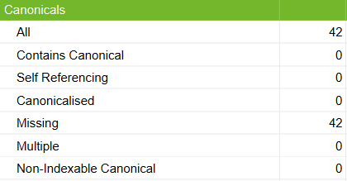
Canonical Tags
https://ty-education.com/
https://ty-education.com/uae-iselect.php
https://ty-education.com/techforbusiness.php
https://ty-education.com/partners.php
https://ty-education.com/uk-iselect.php
https://ty-education.com/indonesia-iselect.php
https://ty-education.com/lifelongskills.php
https://ty-education.com/ty-tir.php
https://ty-education.com/ourvision.php
https://ty-education.com/deliverymodel.php
https://ty-education.com/businessfortech.php
https://ty-education.com/india-iselect.php
https://ty-education.com/insurance-agents.php
http://lms.ty-education.com/
https://ty-education.com/pressrelease.php
https://ty-education.com/wilpower.php
https://ty-education.com/certifications.php
https://ty-education.com/privacy-policy.php
https://ty-education.com/bootcamp.php
https://ty-education.com/instructors.php
https://ty-education.com/ourteam.php
https://ty-education.com/VOD.php
https://ty-education.com/canada-iselect.php
https://ty-education.com/alliances.php
https://ty-education.com/usa-iselect.php
https://ty-education.com/students.php
https://catalog.ty-education.com/tyedu_uscourses
https://catalog.ty-education.com/tyedu_canadacourses
https://catalog.ty-education.com/coursevod?lang=1
http://lms.ty-education.com/login/forgot_password.php
http://lms.ty-education.com/login/signup.php
http://lms.ty-education.com/course/index.php
http://lms.ty-education.com/course/index.php?categoryid=13
http://lms.ty-education.com/course/index.php?categoryid=11
http://lms.ty-education.com/login/index.php
http://lms.ty-education.com/course/index.php?categoryid=10
https://catalog.ty-education.com/tyedu_indiacourses
https://catalog.ty-education.com/tyedu_indonesiacourses
https://catalog.ty-education.com/tyedu_ukcourses
https://catalog.ty-education.com/tyedu_uaecourses
http://lms.ty-education.com/login/
https://catalog.ty-education.com/course_catalog

Slide 9
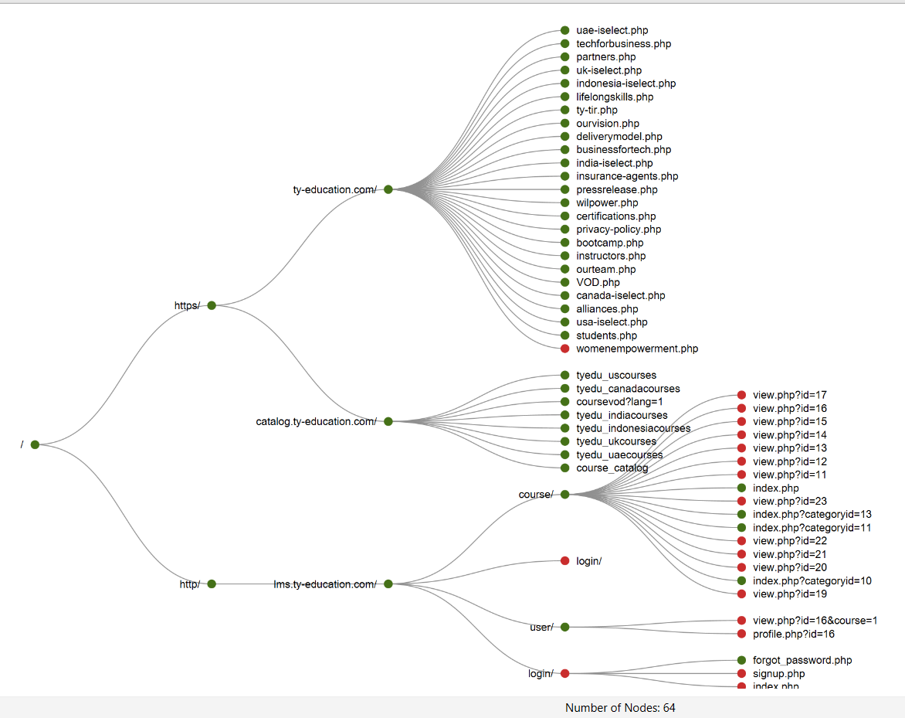

Slide 10
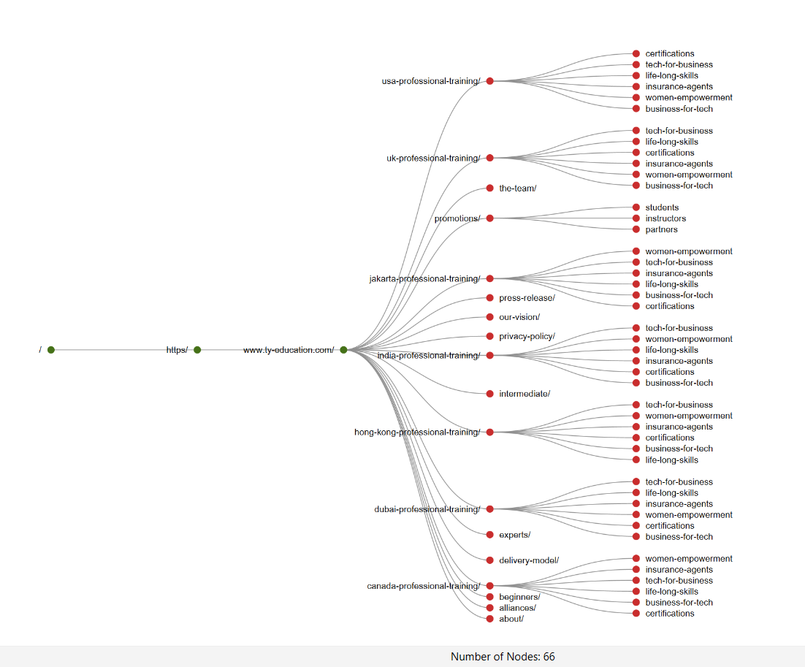

Slide 11
The End

